Slide 1

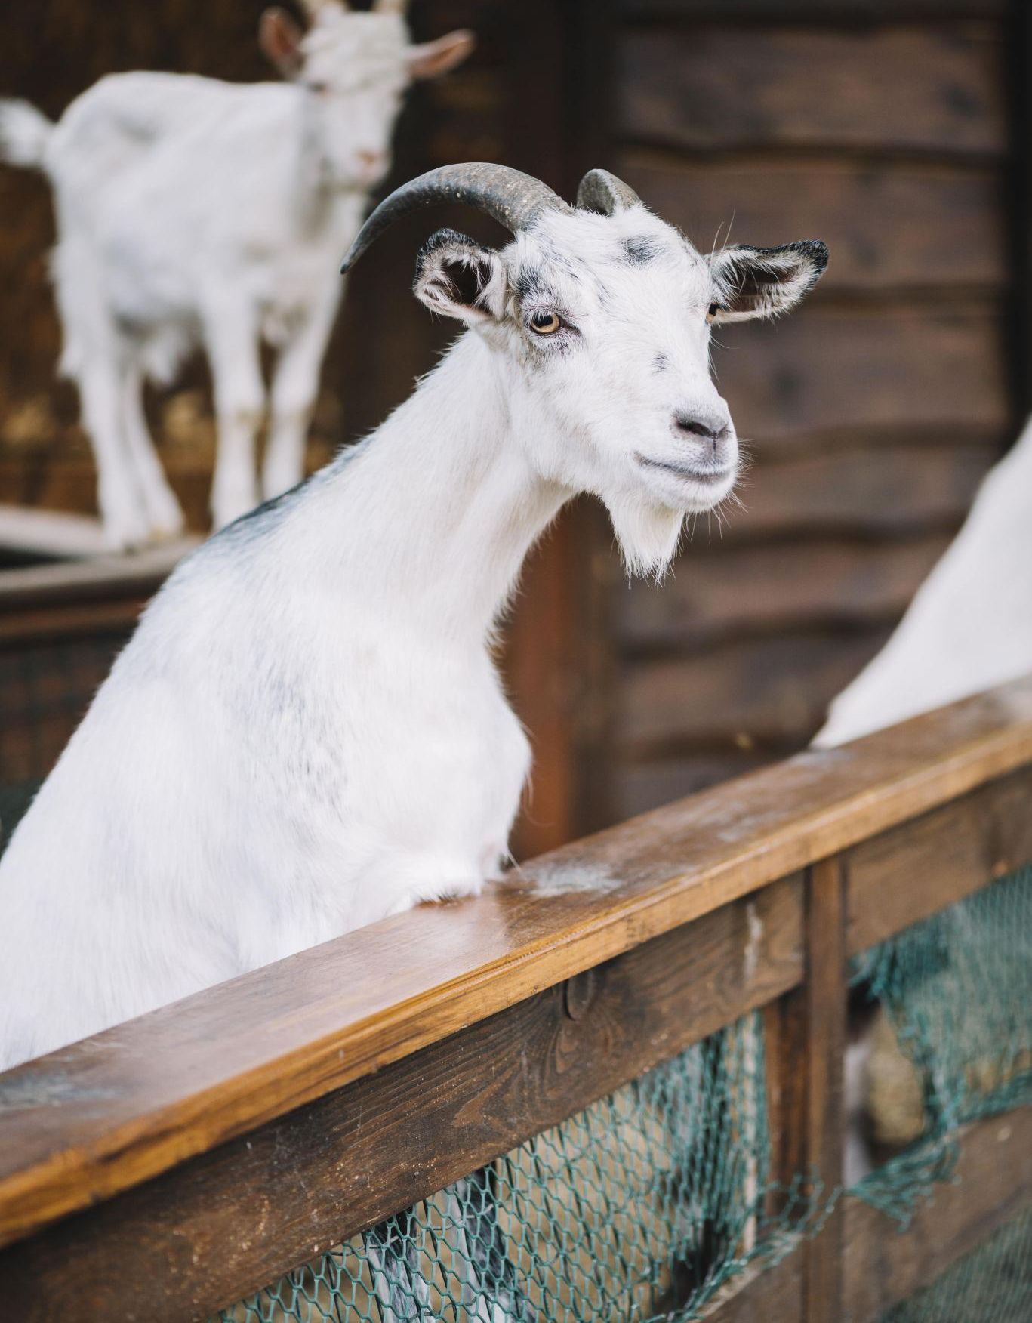
Project: Pasture and Forest
NGUYEN DANG MINH – M23.ICT.008

Slide 2
TABLE OF CONTENTS
01
02
03
04
Introduction
Agents/Behaviors
Extensions
Experiments
01

Slide 3
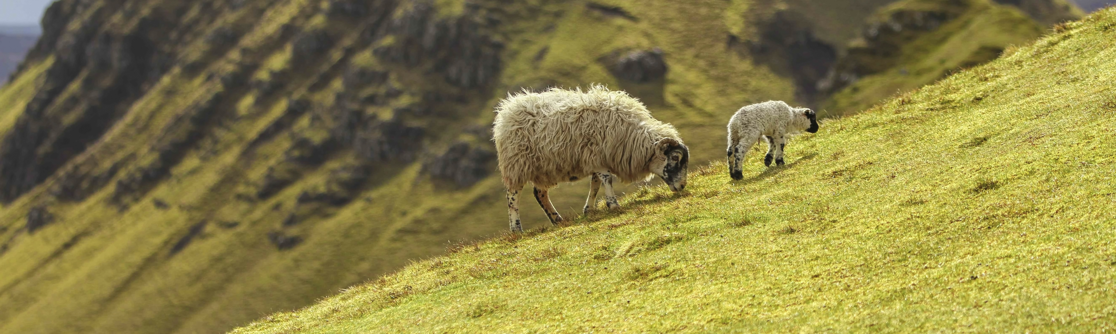
01
Introduction
02

Slide 4
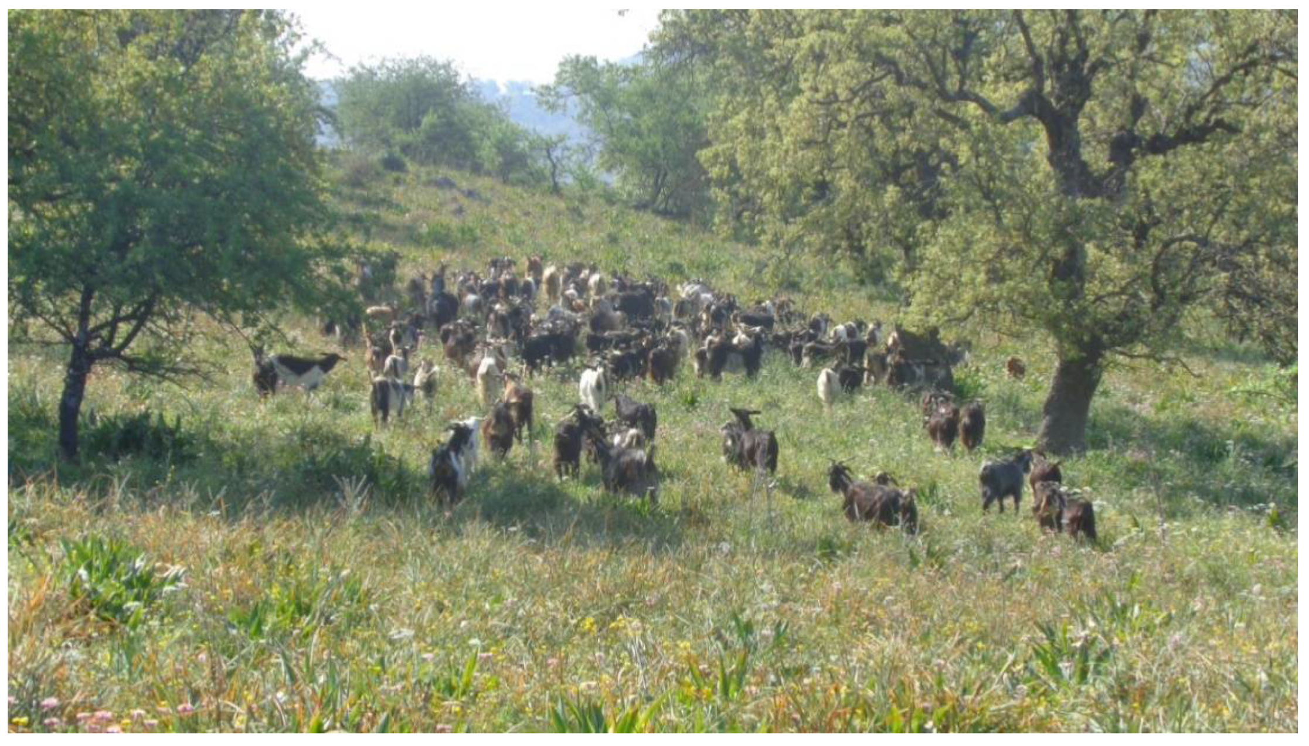
Context
Grazing herds impact forest ecosystems, posing challenges for pastureland management.
Shepherds manage Logo goat herds in forests dominated by Cormasis gama trees.
Cormasis gama groves provide high nutritional value for goats but degrades groves.
Overgrazing led to deforestation
03

Slide 5
Objectives
Behavior Simulation: Model the decision-making process of shepherds and herds in forest and pasture, influenced by factors like forest size, food availability, and shepherd perception.
Regulation Impact: Assess how individual shepherd attitudes toward Forest Department regulations contribute to forest degradation.
Sustainability Threshold: Identify the minimum probability of respectful behavior among shepherds required to sustain forest cover and avoid total deforestation.
04

Slide 6
02
Agents
05

Slide 7
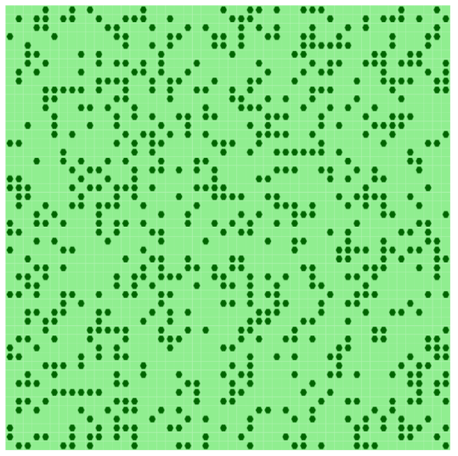
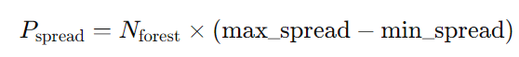
Grid-based lands agents
The forest ecosystem is modeled as a 2D grid where a percentage of the grid cells are populated by Trees/groves.
Behaviors
Tree spread : The probability of the forest expanding into a pasture cell
Figure 1: 50x50 2D grid with 30% populated by Cormasis gama trees.
06

Slide 8
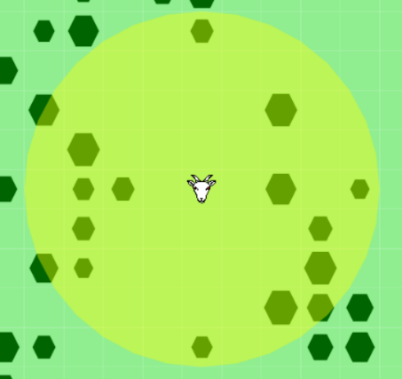
Shepherd/Herd Dynamics
Herds move around the grid based on perception_range and available unoccupied lands by another herds.
Herds prefer forested cells but can settle in pasture lands if no forest is visible.
Herds graze the tree cell into pasture cell.
Figure 2: Herd and its perception
07

Slide 9
03
Extensions
08

Slide 10
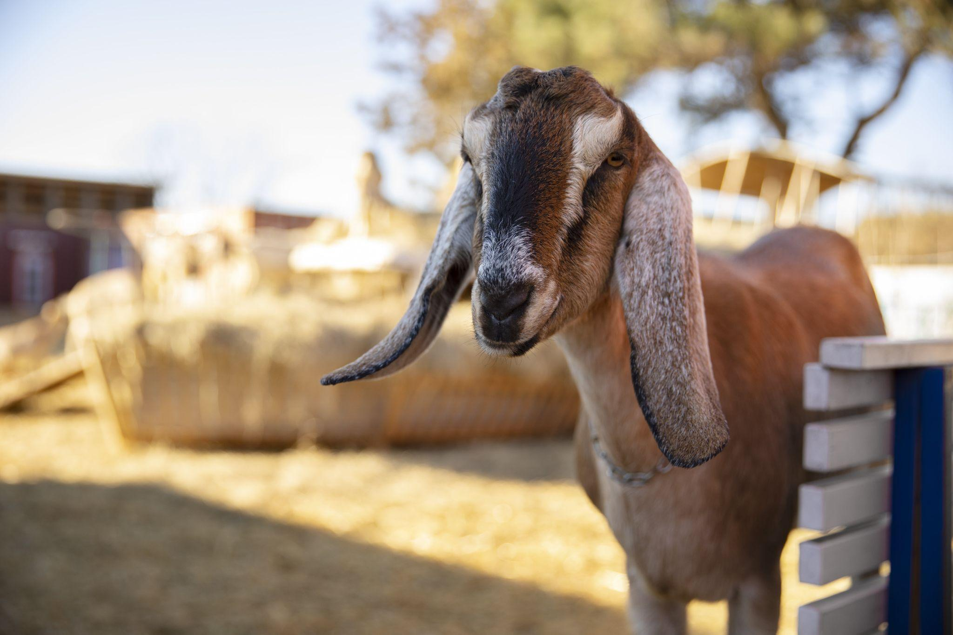
What would be the future of such a socio-ecosystem: If all shepherds were to enter the forest without any regulation ?
09

Slide 11

Simulation time tracking
To fully simulate a grazing season, we track the passage of both months and seasons based on cycle passed.
This time-tracking mechanism enables us to update reflexes more slowly based on changes in month and season, allowing for a more realistic simulation of seasonal dynamics in the grazing process
10

Slide 12
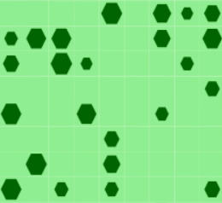
Update groves cells behaviors
Each forest cell has a density value representing grove health and influencing forest spread.
New cells inherit an average density from neighboring cells.
Growth: Density increases monthly, capped at 1.0 to prevent overgrowth.
11

Slide 13
Herds/Shepherds
Herds are now accompanied by shepherds, who guide their movement within a defined perception range.
Shepherds relocate monthly; herds move locally around their starting position.
Movement Priority: Stay > Grove > Pasture
Grazing: Herds graze on forest cells, reducing density. Low-density forest cells transition into pastureland.
12

Slide 14
What would be the future of such a socio-ecosystem: If all shepherds were to follow their idea about the minimum size?
13

Slide 15
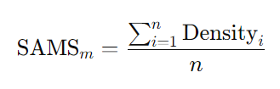
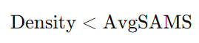
Self-authorized minimum size
Shepherds now rely on the memory of past months to refine their herds’ grazing behavior. At the end of each month, each shepherd calculates a “self-authorized minimum size” indicator.
Herds are prohibited from grazing on grove cells:
When the next grazing season begins, these individual memories are reset.
14

Slide 16
What would be the future of such a socio-ecosystem: What if all shepherds were to follow the Forest Department's regulations?
15

Slide 17
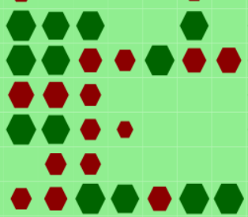
Institutional authorized minimum size
At the end of the grazing season, the Forest Department determines an institutional authorized minimum size:
This is calculated as the average of self-authorized minimum sizes reported by shepherds at the end of the season.
Groves with a density below this institutional minimum size are marked as “protected” for the upcoming grazing season.
16

Slide 18
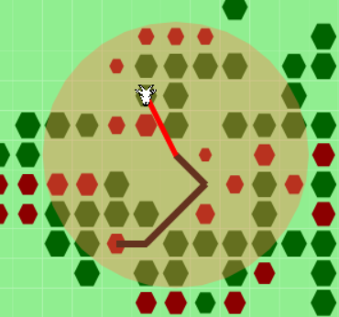
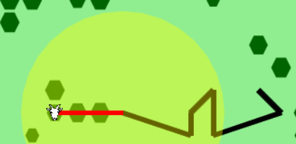
Respectful vs. Disrespectful Shepherds
Respectful
Disrespectful
Avoid grazing on groves marked as protected.
Refrain from grazing on forests smaller than their individual self-authorized minimum size.
Ignore the institutional regulations and protected groves.
Only avoid grazing on forests smaller than their individual self-authorized minimum size.
17

Slide 19
04
EXPERIMENTS
18

Slide 20
Defined Experiments
All experiments utilize the default parameter (details in the report).
Each experiment includes 20 repeated simulations performed via batch runs.
Results are saved to CSV files for analysis.
Simulation name | Respectful Rate | Deforestation Status | Last Seasons | Percentage of Groves | Total Biomasses | Sustainability
Simulation 4 | 1 | FALSE | 51 | 0.3796 | 746.4394 | TRUE
Simulation 0 | 1 | FALSE | 51 | 0.392 | 773.1511 | TRUE
Simulation 6 | 1 | FALSE | 51 | 0.4572 | 974.5906 | TRUE
19

Slide 21
Defined Experiments
Sustainability is a boolean value that indicates whether the forest can regain the groves that herds grazing during 50 seasons.
Sustainability is True if the forest cover at the end of the season is greater than or equal to the initial forest cover.
Sustainability is False if the forest cover decreases by the end of the season.
20

Slide 22
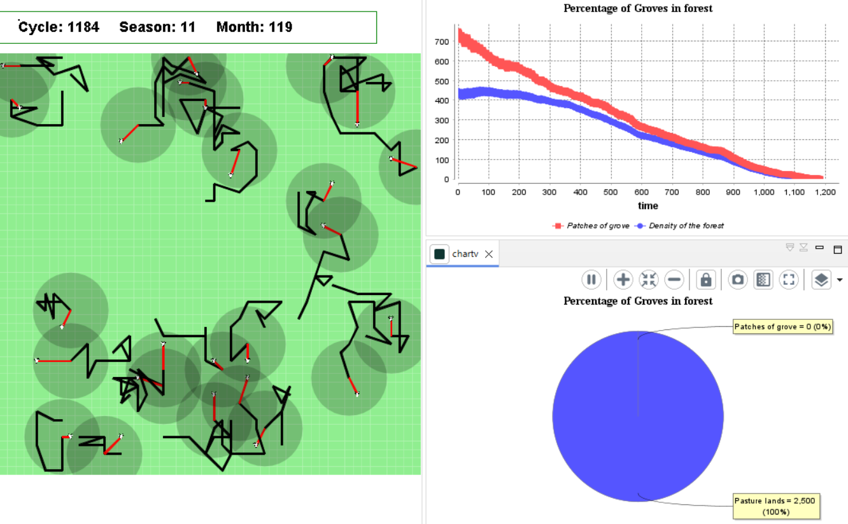
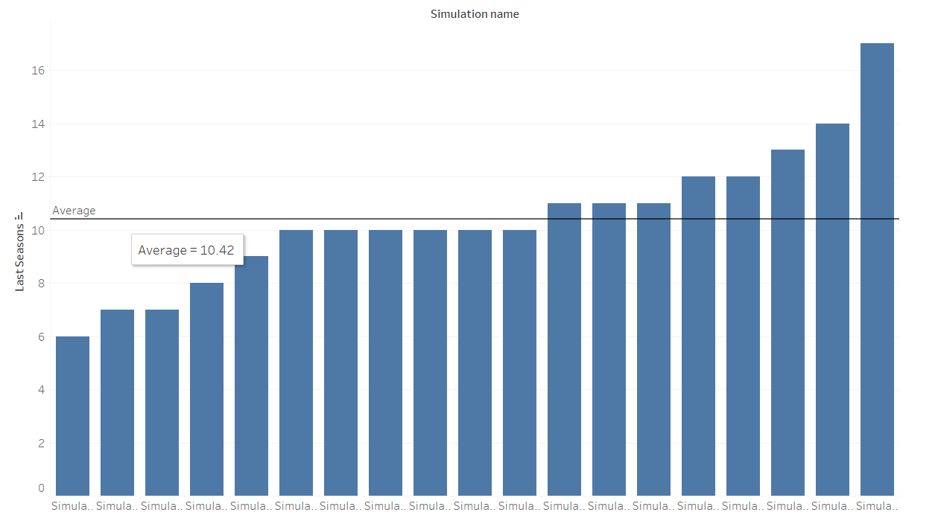
Experiment 1: NO REGULATION.
All simulations resulted in true deforestation, indicating that without any respect for forest regulations, the forest ecosystem cannot sustain itself.
21

Slide 23
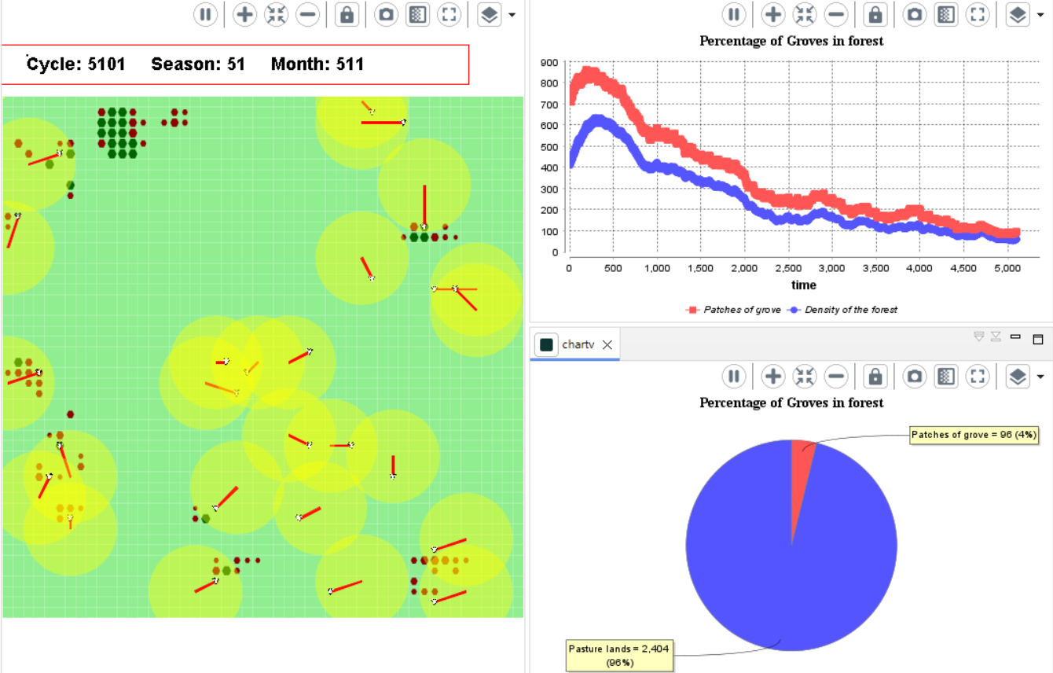
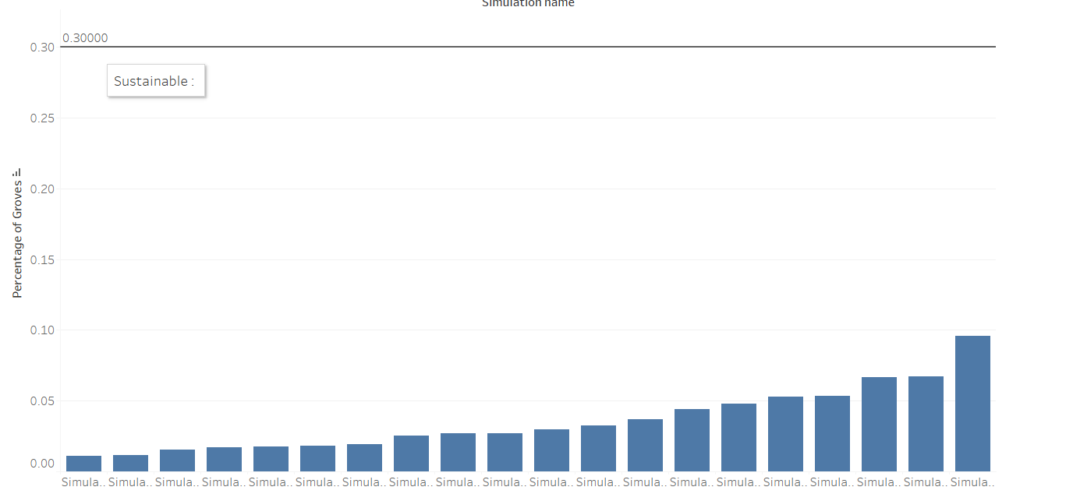
Experiment 2: SELF-REGULATION
When shepherds operate under self-regulation without follow to external institutional rules, the outcomes reveal persistent deforestation and an inability to achieve sustainability.
22

Slide 24
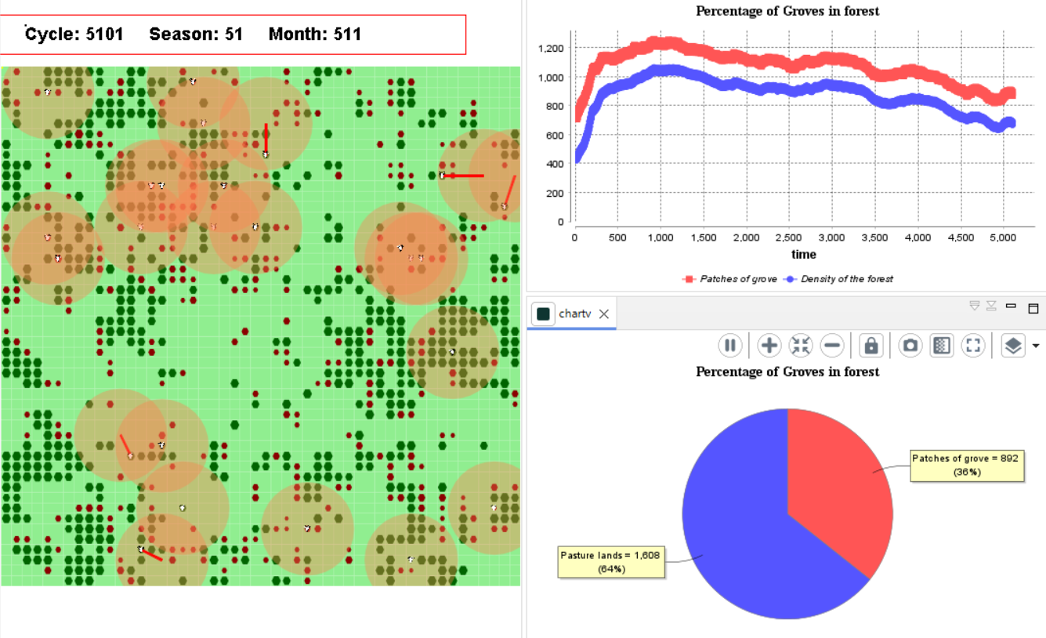
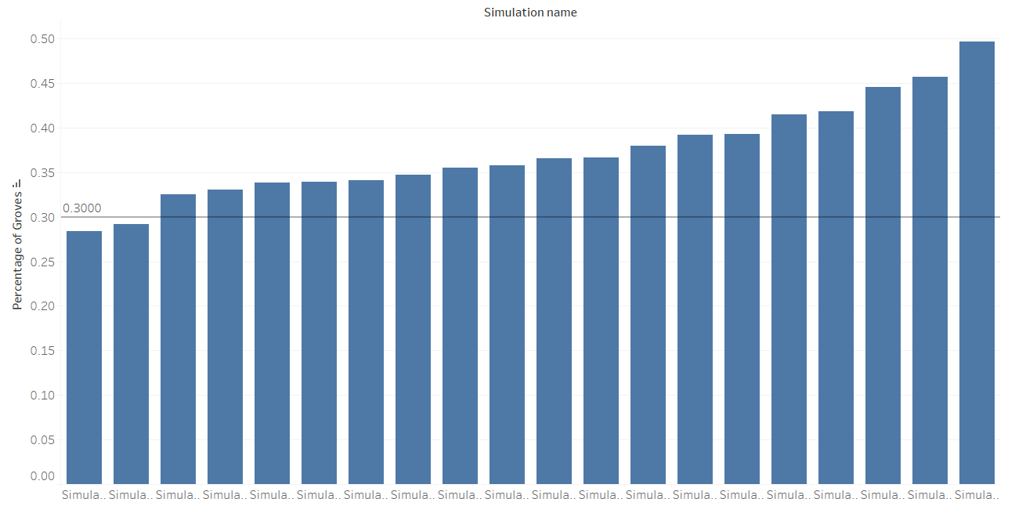
Experiment 3: FULL-REGULATION
When shepherds follow institutional rules and respect protected groves, the simulation results reveal an improvement in forest sustainability
23

Slide 25
WAIT…
What is the minimum probability of respectful behavior among shepherds that is required to maintain a sustainable forest cover and prevent total deforestation ?
24

Slide 26
Experiment 4: EXPLORE RESPECTFUL RATE
Change the "Respectful Rate" from 0.0 to 1.0 in steps of 0.1.
5 simulation repeats for each value.
Track sustainability using the "Sustainability" column in the results.
25

Slide 27
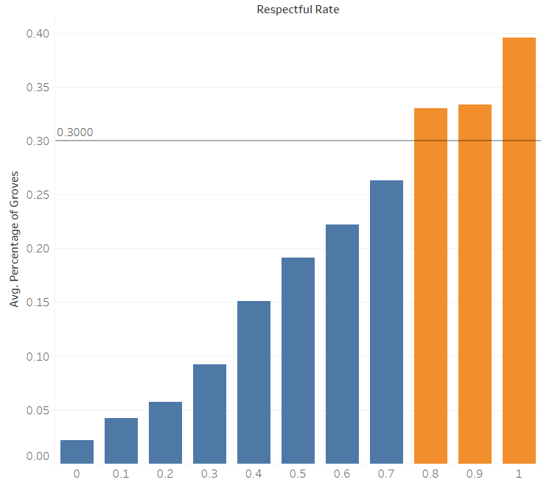
Experiment 4: EXPLORE RESPECTFUL RATE
Positive correlation between the percentage of groves and the respectful rate.
Respectful Rate 0.0 to 0.4 No sustainability.
Respectful Rate 0.5 to 0.7 : a mixed result, but some do achieve sustainability.
Respectful Rate 0.8 and higher: Most simulations achieve sustainability.
26

Slide 28
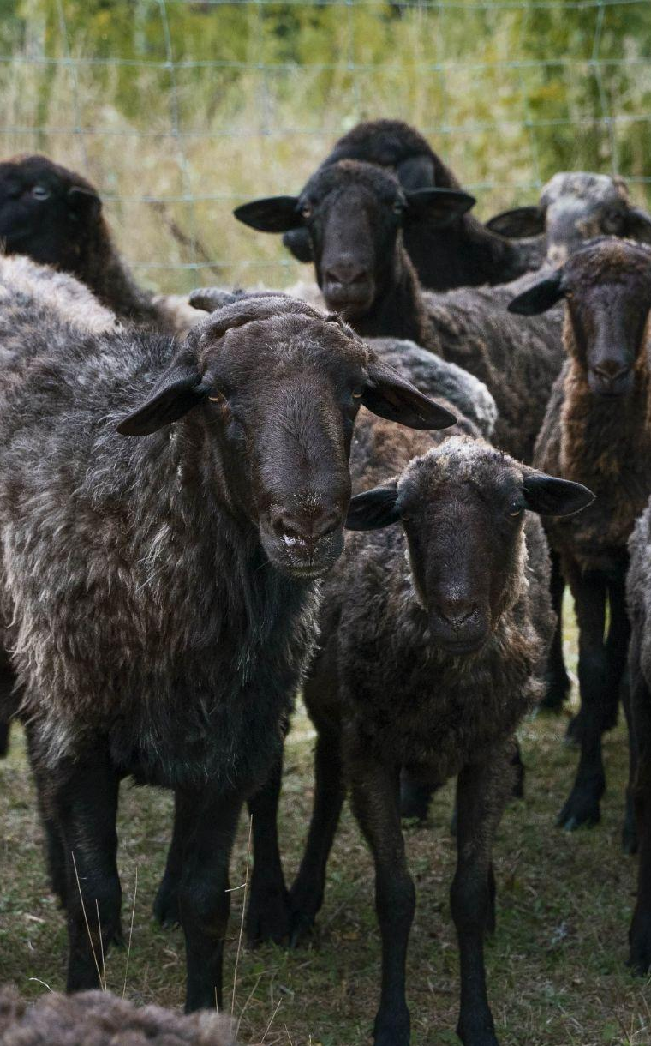
THANKS!
DO YOU HAVE ANY QUESTIONS?
Please keep this slide for attribution

